Slide 1

Module 2- Big Data Infrastructure
Hadoop Ecosystem-HIVE

Slide 2

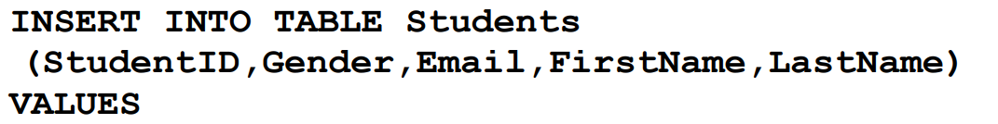
Hadoop Ecosystem-HIVE
Insertion in HIVE
Can insert Multiple records in a table
Can change the number of columns, data types of columns
Can import data into the table from other files load data local inpath Overwrite
Can import from one table to another table
It just copies the file into append
Hive expects the data in the table directory in a specific format, if mismatch, HIVE can’t read that data from the file.

Slide 3
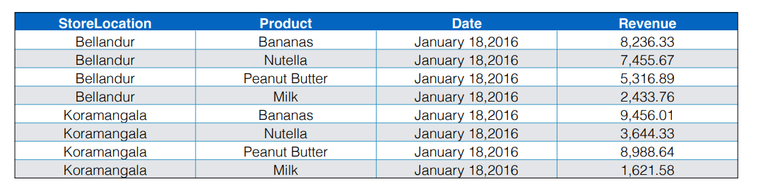
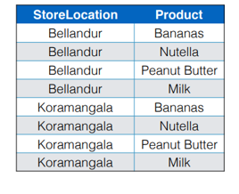
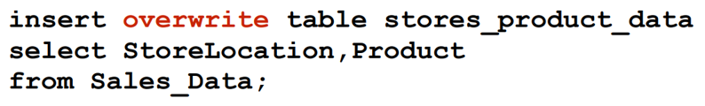
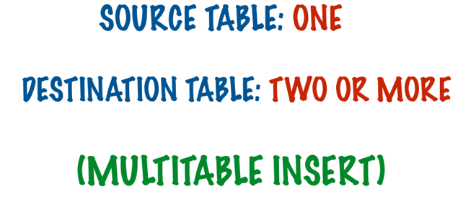
Hadoop Ecosystem-HIVE
Insertion

Slide 4
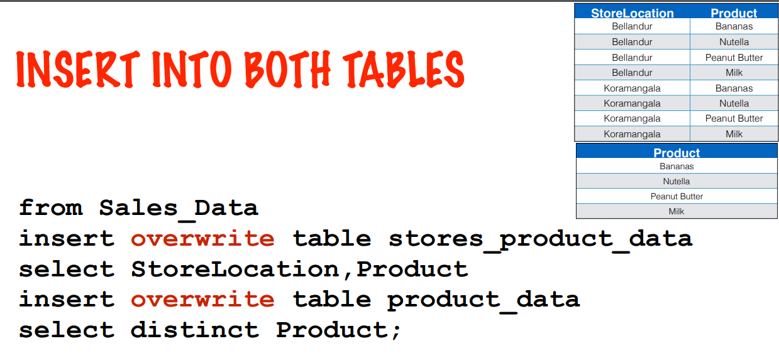
Hadoop Ecosystem-HIVE
Multi Table Insertion

Slide 5
ALTERING TABLES

Slide 6

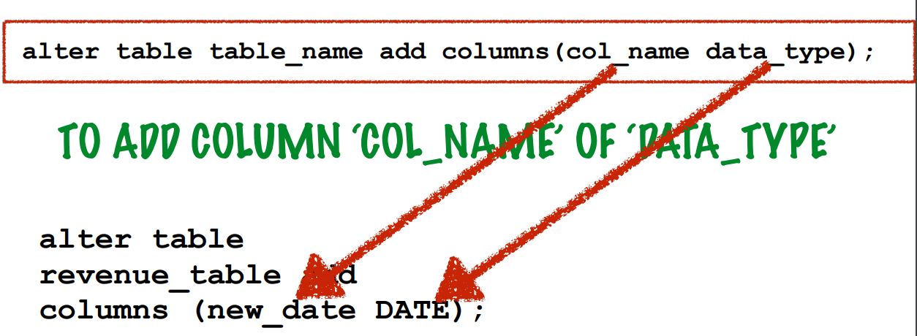
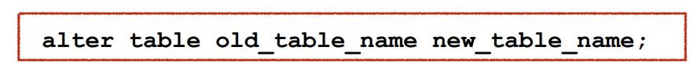
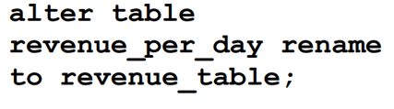
Hadoop Ecosystem-HIVE
Alter Tables- How Hive allows us to change the structure of the table?
More or less similar to MYSQL
HIVE allows us to change the number of columns, data types of columns, names of columns etc
HIVE is batch processing as the data is stored in a distributed manner compound operations creating and altering table at the same time is not allowed

Slide 7
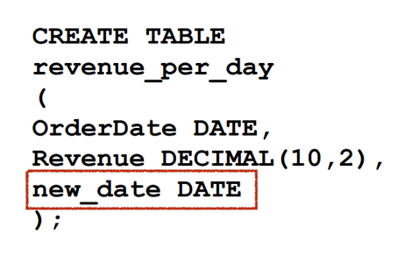
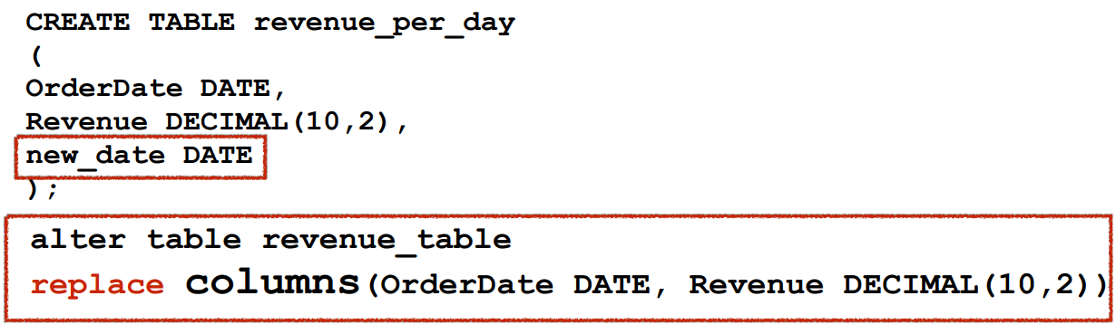
Hadoop Ecosystem-HIVE
Alter Tables- Deleting a column in HIVE

Slide 8
DELETING TABLES

Slide 9

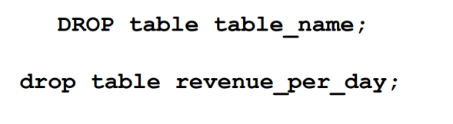

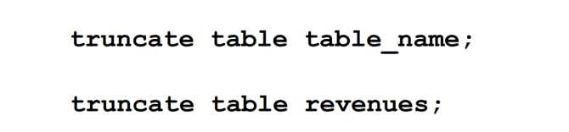

Hadoop Ecosystem-HIVE
Deleting Tables- Same as SQL
Delete Table Data without deleting table

Slide 10
HIVE OPERATORS AND FUNCTIONS

Slide 11
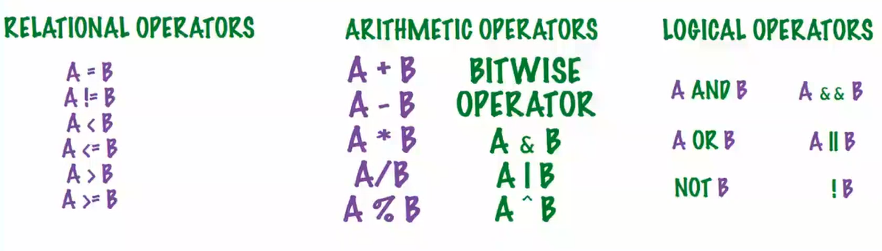
Hadoop Ecosystem-HIVE
HIVE Operators

Slide 12
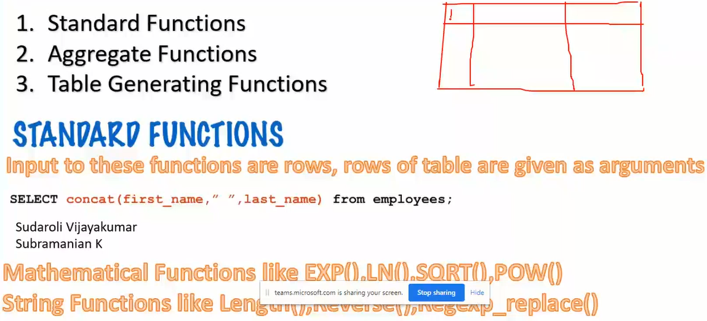
Hadoop Ecosystem-HIVE
HIVE Functions

Slide 13
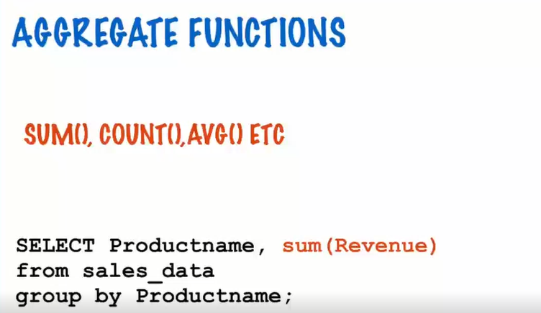
Hadoop Ecosystem-HIVE
HIVE Functions

Slide 14
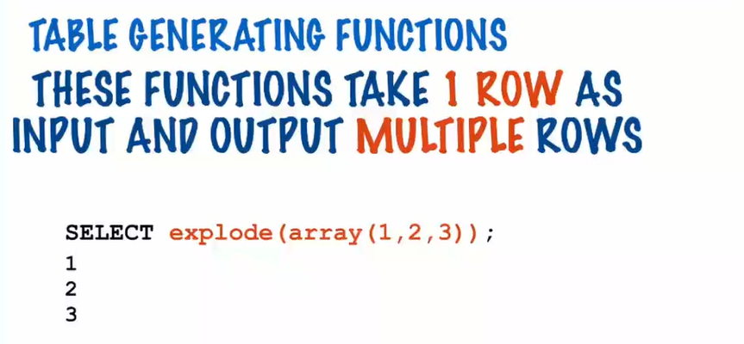
Hadoop Ecosystem-HIVE
HIVE Functions

Slide 15
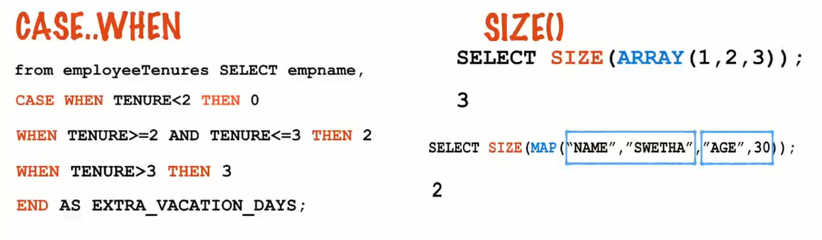
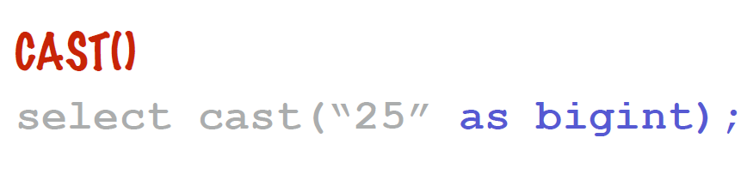
Hadoop Ecosystem-HIVE
HIVE Libraries

Slide 16
Partitioning

Slide 17
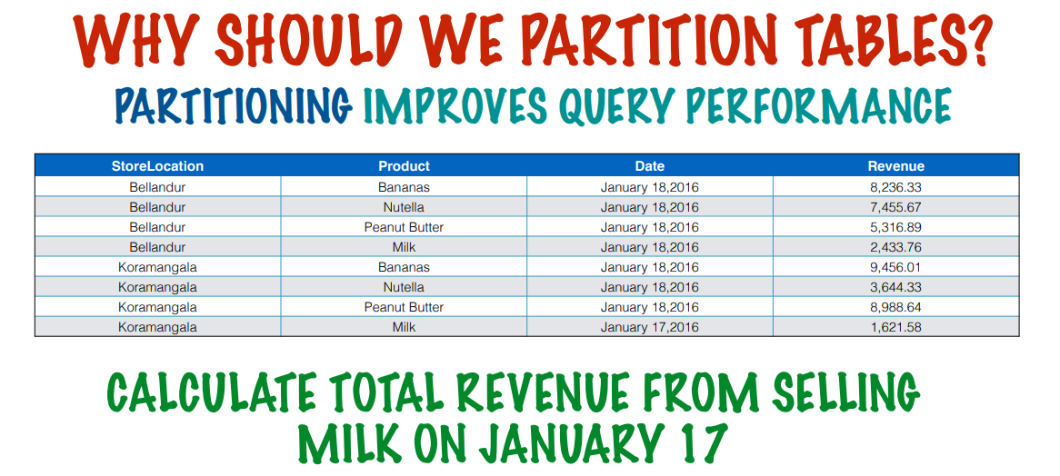
Hadoop Ecosystem-HIVE
HIVE Partitioining

Slide 18
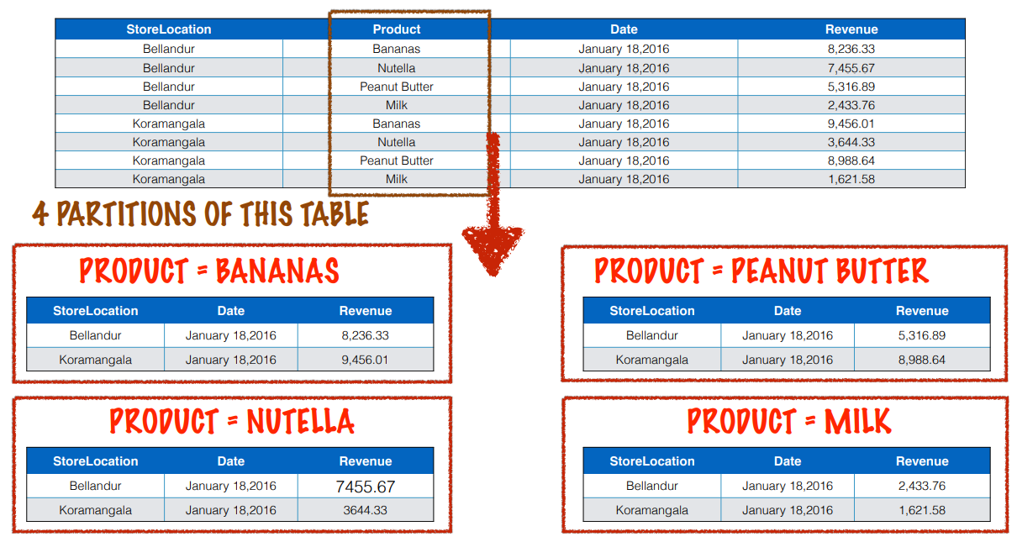
Hadoop Ecosystem-HIVE
HIVE Partitioning

Slide 19
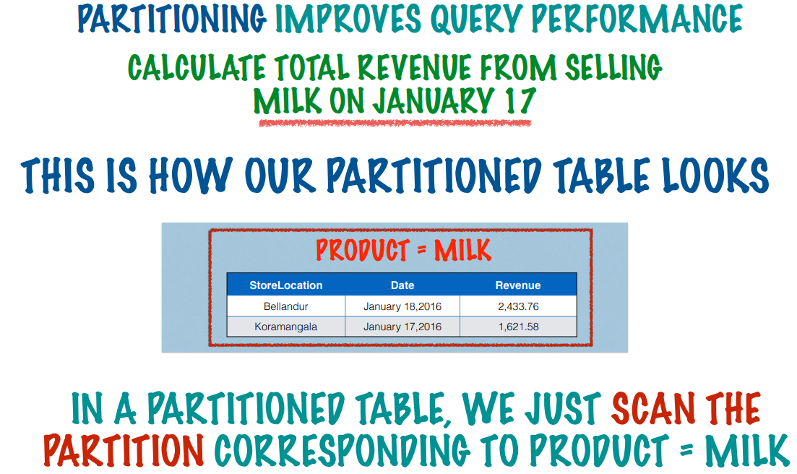
Hadoop Ecosystem-HIVE
HIVE Partitioning

Slide 20
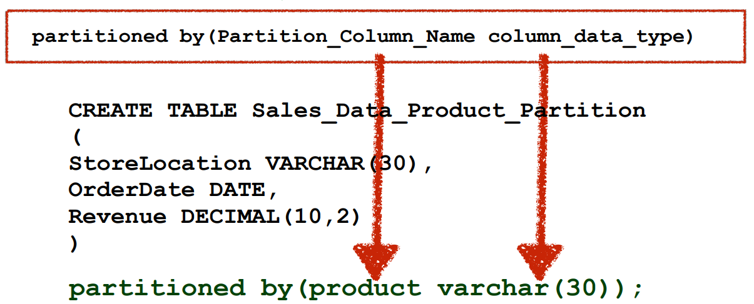
Hadoop Ecosystem-HIVE
HIVE Partitioning

Slide 21
Bucketing

Slide 22
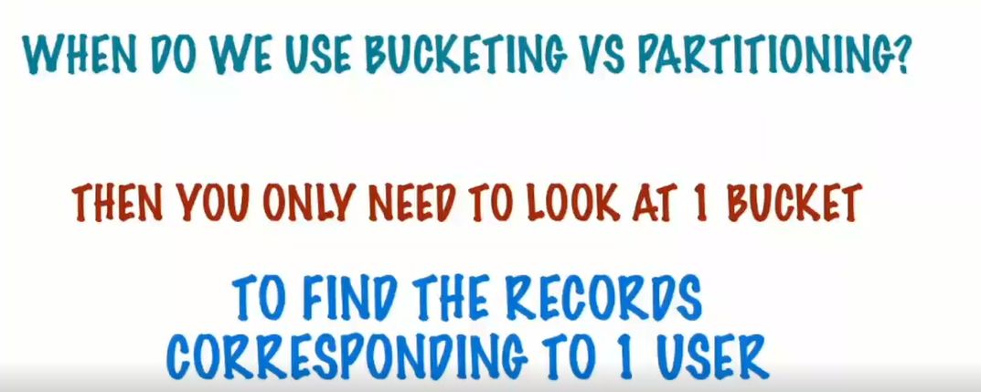
Hadoop Ecosystem-HIVE
HIVE Bucketing

Slide 23
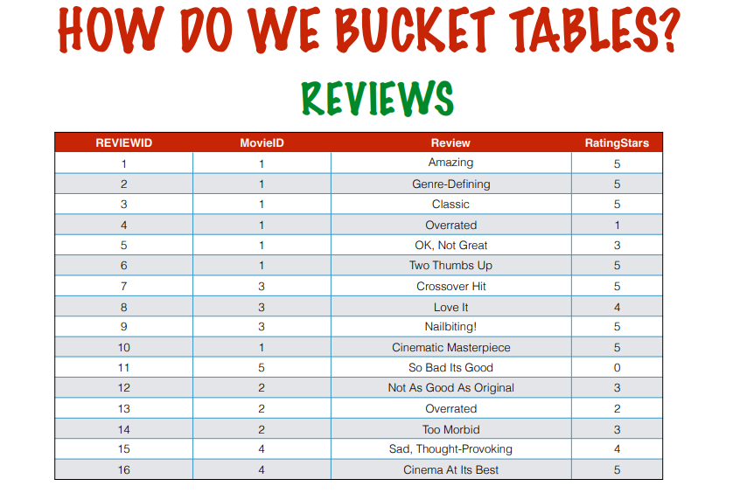
Hadoop Ecosystem-HIVE
HIVE Bucketing

Slide 24
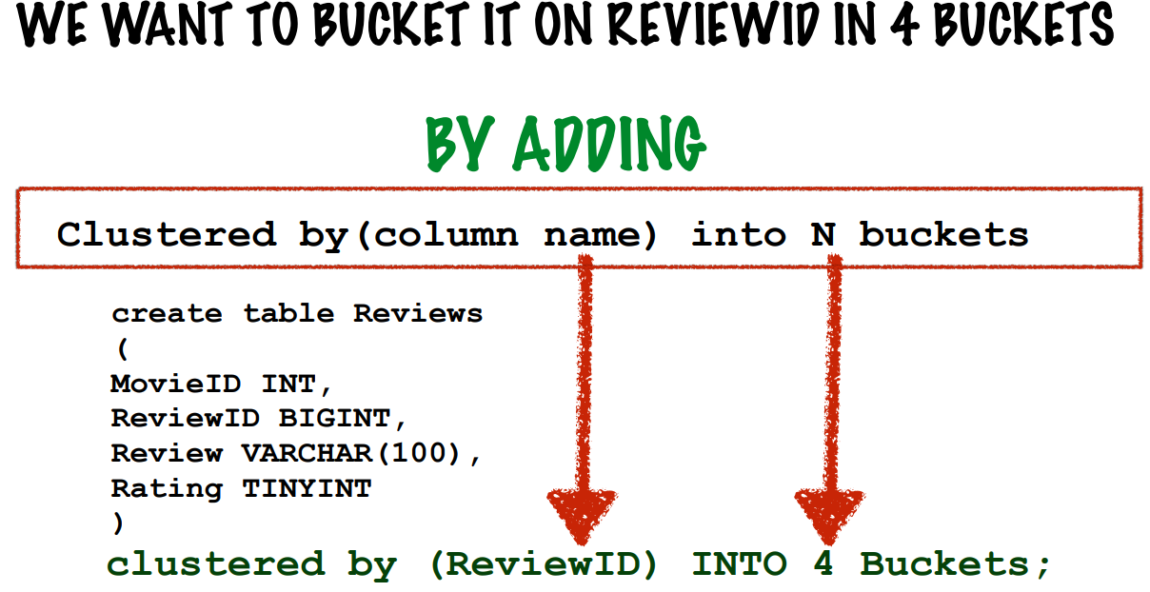
Hadoop Ecosystem-HIVE
HIVE Bucketing

Slide 25
Windowing

Slide 26
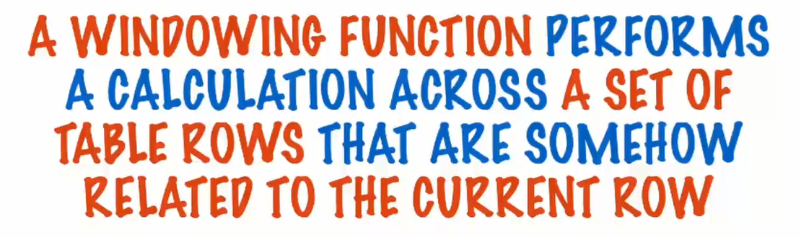
Hadoop Ecosystem-HIVE
Windowing in HIVE

Slide 27
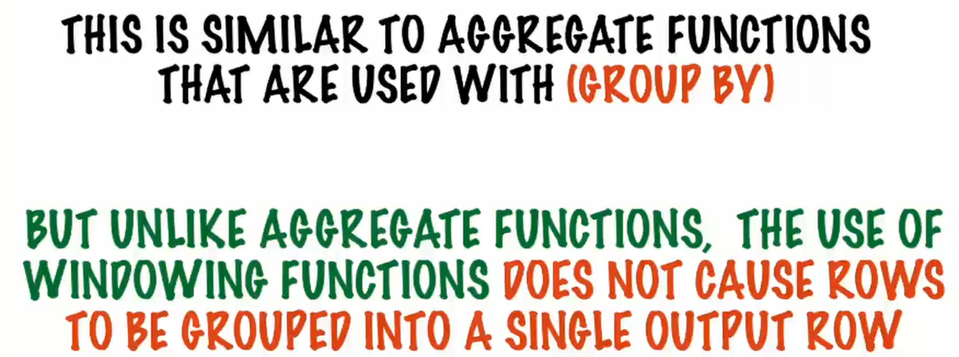
Hadoop Ecosystem-HIVE
Windowing in HIVE

Slide 28
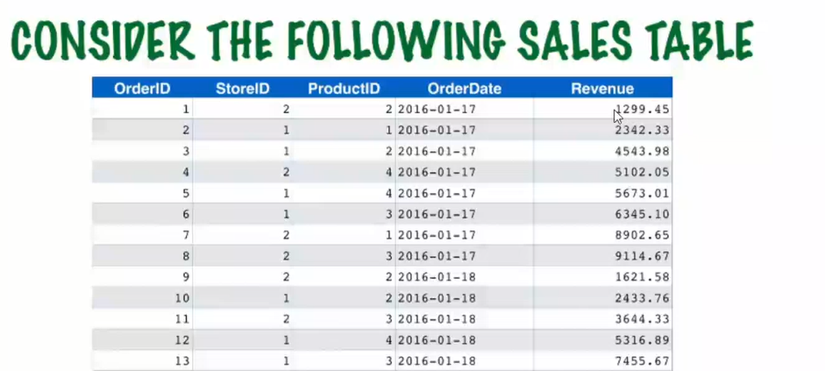
Hadoop Ecosystem-HIVE
Windowing in HIVE

Slide 29
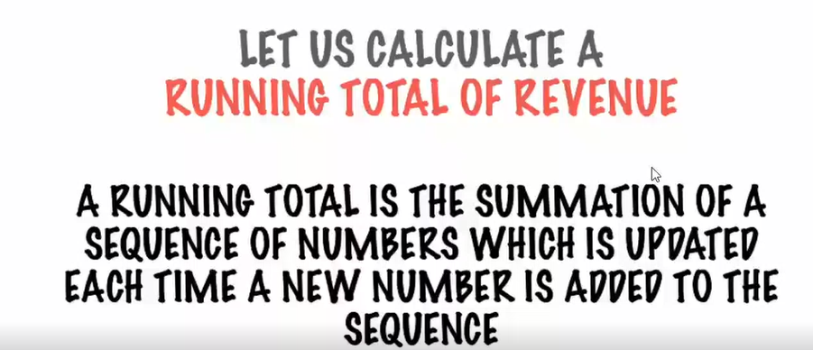
Hadoop Ecosystem-HIVE
Windowing in HIVE

Slide 30
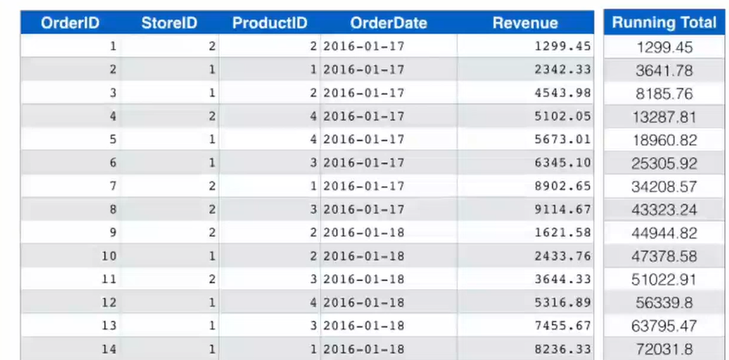
Hadoop Ecosystem-HIVE
Windowing in HIVE

Slide 31
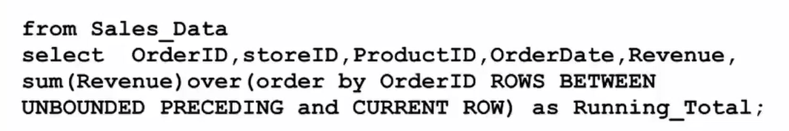
Hadoop Ecosystem-HIVE
Windowing in HIVE

Slide 32
HIVE CONCLUDED
Self study can be done advanced topics like windowing, Joins, Custom functions in python

Slide 33
THANK YOU
“WORLD IS ONE BIG DATA PROBLEM”
“TORTURE THE DATA AND IT WILL CONFESS TO ANYTHING”

